Slide 1

Predicting Prognosis Based on Patient History Using Machine Learning
Chang-Joon Lee

Slide 2
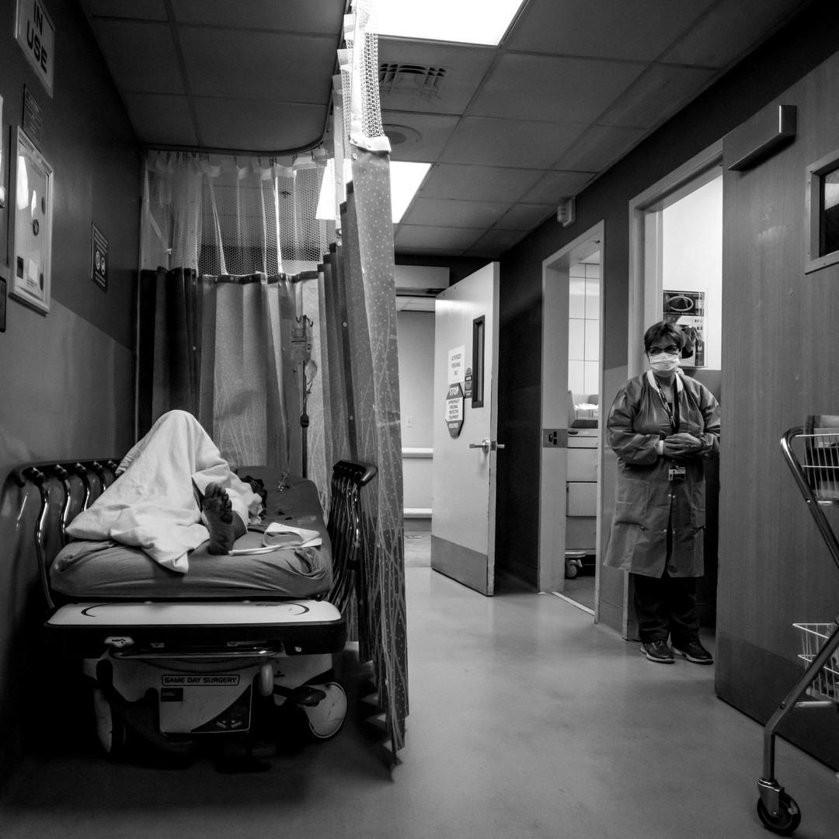
Motive – Why Are We Doing This?
Avoid Inappropriate Hospitalisation (IH)
Use of hospital services for patients that the treatment had no benefit for them or the case that treatment can be delivered at less specialised levels with the same quality.
INCREASE in Hospital Costs
DECREASE in Available Resources
RISK of In-Hospital Infections
Optimal Resource Allocation IMPORTANT

Slide 3
Key Statistics on IH
Up to:
78% in Elderly
54% in Adult
20% in Children^{1,2}
90% of IH attributed to the hospital or the doctor³
Estimated Cost of IH ~€2.1 million per year (NZ $3.5 million)⁴
Coast J et al. (1996). Factors Associated with inappropriate emergency hospital admission in the UK. Int J Qual Health Care
Levis JN, Anderson GM. (1996). Appropriateness in health care delivery: definitions, measurement and policy implications. CMAJ
De la Fuente D et al. (1996). Inappropriate hospitalisation: reasons and determinants. EJPH
Soria-Aledo V et al. (2009). Associated factors and cost of inappropriate hospital admissions and stays in a second-level hospital. Am J Med Qual.

Slide 4
Objective
Business Objective:
Build a Predictive Model based on ML that can CORRECTLY predict:
True Discharge
True Hospitalisation
Minimise the Number of IH based on CORRECT PREDICTION of PROGNOSIS
True Cases:
Patients CORRECTLY classified as Discharge or Hospitalisation
False Cases:
Patients INCORRECTLY classified as Discharge or Hospitalisation
Modelling Objective:
MAXIMISE: True Cases
MINIMISE: False Cases

Slide 5
How Will We Do This?
1. Find a Dataset
EDA
Data Cleaning & Manipulation
Feature Selection & Engineering
2. Pre-Process the Data
3. Model Training & Validation
Logistic Regression
Support Vector Machine (SVM)
Naïve Bayesian Model (NB)
4. Final Model Testing

Slide 6
Finding a Dataset
Diabetes 130 – US Hospitals for Years 1999 – 2008 (from UCI Machine Learning Repository)¹
Total of > 100,000 records with 50 features.
Features Types | Description | No. of Features | % Missing
Patient Identifier | Unique identifier of a patient & hospital admission | 2 | 0%
Patient Information | Race, gender, age, weight and prior hospitalisation records | 9 | 97%
Admission/Discharge | Identifiers indicating the type of admission and discharge | 2 | 0%
Hospital Administration Information | Hospital administration records (e.g. time in hospital, payment method) | 4 | 53%
Lab Tests & Procedures | Number of lab tests & procedures performed | 4 | 0%
Diagnosis | Diagnosis made by the doctor at the time of admission | 3 | 0%
Medications | The type of medications administered during hospital stay | 26 | 0%
1. Strack B et al. (2014) Impact of HbA1c Measurement on Hospital Readmission Rates: Analysis of 70,000 Clinical Database Patient Records. BioMed Research International

Slide 7
Pre-Processing the Data
Only features gathered AT THE TIME of hospital admission were considered.
The goal of the model is to predict the likely prognosis AT THE TIME OF ADMISSION.
Non-health related information were discarded.
Records with missing or unknown values were discarded UNLESS the missing information can be replaced from the data itself or from external sources.
All non-numeric categorical values (e.g. Yes/No) were replaced with numerical labels (e.g. 0 & 1), and were given dummy variables for efficient machine learning.
Final Dataset: ~72,000 records with 15 features

Slide 8
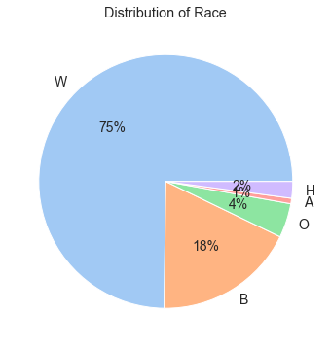
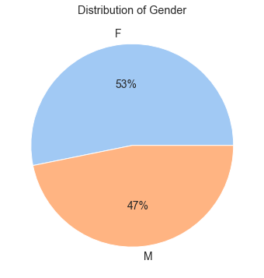
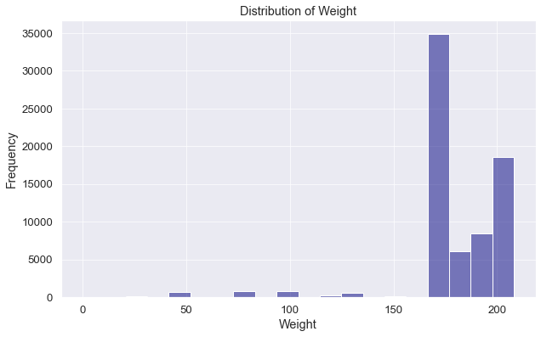
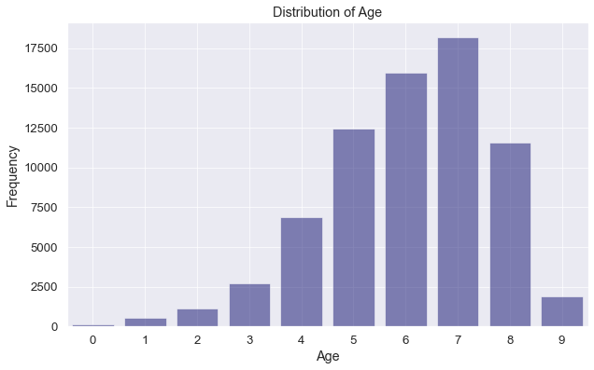
EDA– Patient Information
The majority of the race is either Caucasian (white) or African American (black) accounting for 93% of the total data.
The gender distribution is roughly even, with slightly more females (53%) than males (47%).
The majority of the patients in the data are age 50 or older.
Most of the patients weight more than 160 pounds.

Slide 9
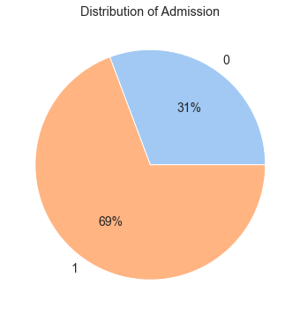
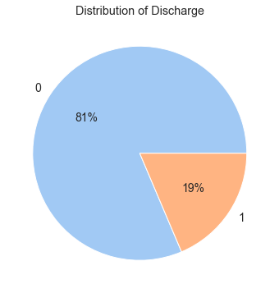
EDA – Admission/Discharge
Around 70% of the patients came to the hospital as an emergency admission.
Around 20% of the patients left the hospital in a serious condition (either deceased or long-term hospitalisation of more than 25 days).

Slide 10
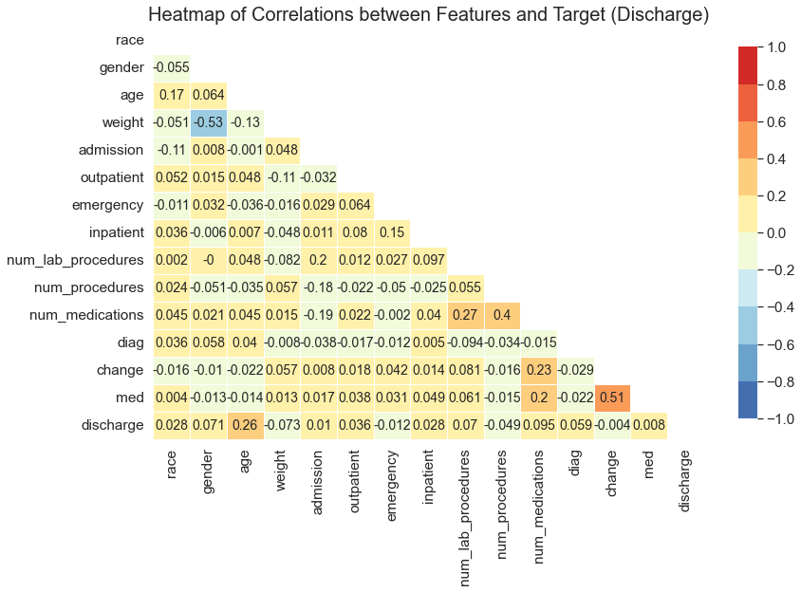
EDA - Correlations
Age has the strongest correlation to discharge status (0.28).
Other features all have very weak (negligible) correlation.
Given that most features have very weak correlations, we will include all features for ML.

Slide 11
Machine Learning
Dataset
Standardise all numerical values
Random sampling 5000 samples
Train (65%) – Validation (15%) – Test (20%)
Classification Target: Discharge Status
Logistic Regression
Gridsearch Criteria:
Penalty: l1, l2
C: 2^{i}, i = -5 to 15
Support Vector Machine (SVM)
Gridsearch Criteria:
C: 2^{i}, i = 0 to 8
gamma: 2^{i}, i = -13 to -1
kernel: rbf, sigmoid, linear
Naïve Bayesian (Gaussian)
Gridsearch Criteria:
var_smoothing: 0 to -9
Final Model

Slide 12
ML – Training Scores
Model | Best Hyperparameters | Cross-Validation Score*
Logistic Regression | C = 8.0, penalty = l1 | 0.819
SVM | C = 6.35, gamma = 0.5, kernel = rbf | 0.888
NB | var_smoothing = 0.01 | 0.684
* Training score indicates how the model generalised or fitted in the training data.
We don’t necessarily want very high training score (1.0) but want to make sure the training score is close to the validation and test scores to ensure the model is not over-fitted.

Slide 13
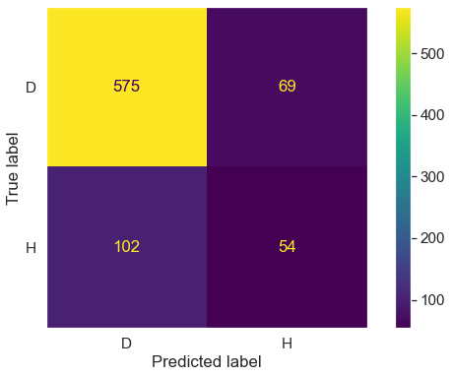
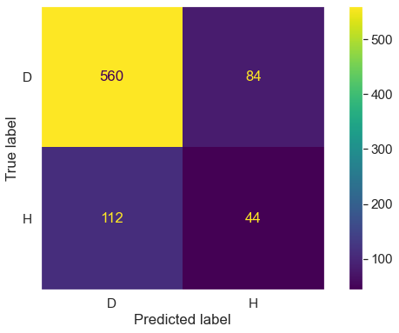
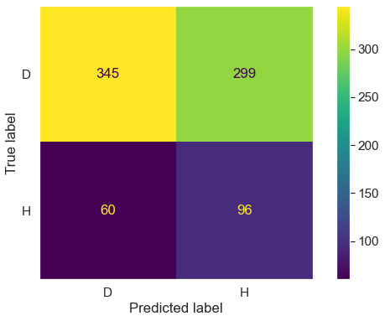
ML – Validation Scores
Logistic Regression
SVM
NB
Accuracy: 0.786
Recall: 0.89 (D) & 0.35 (H)
Precision: 0.85 (D) & 0.44 (H)
Accuracy: 0.755
Recall: 0.87 (D) & 0.28 (H)
Precision: 0.83 (D) & 0.34 (H)
Accuracy: 0.551
Recall: 0.54 (D) & 0.62 (H)
Precision: 0.85 (D) & 0.24 (H)
Logistic Regression was the most accurate, but performed poorly in correctly identifying true hospitalisation cases
NB was the best at predicting true hospitalisation cases but at the cost of misclassifying true discharge cases.

Slide 14
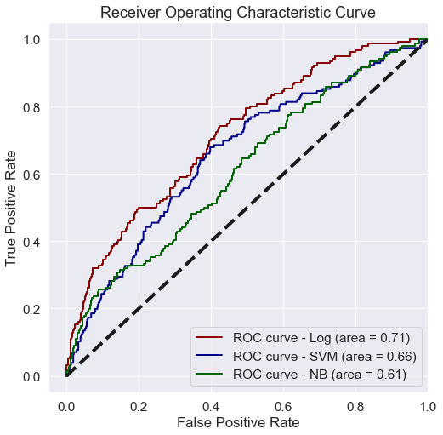
ML – Validation Scores
A model whose predictions are 100% wrong: AUC = 0.0
A model whose predictions are 100% correct: AUC = 1.0.
Best Model = Logistic Regression
Problem:
The current model is bad at identifying true hospitalisation cases.
Need OPTIMSIATION

Slide 15
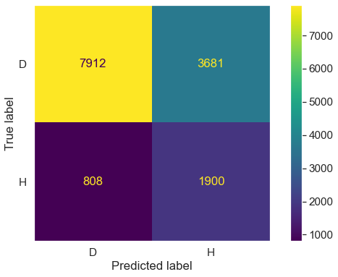
ML – Optimisation & Final Prediction
Two Methods:
Increase the number of data (use entire 71,000 records)
Find a threshold that give optimal balance between predicting true discharge and predicting true hospitalisation.
Accuracy: 0.686
Recall: 0.68 (D) & 0.70 (H)
Precision: 0.91 (D) & 0.34 (H)
The model can predict both true discharge and true hospitalisation cases with 70% accuracy.
The predictions for both discharge and hospitalisation cases will be correct around 70% of the time.

Slide 16
Conclusion & Recommendations
As a proof of concept model, the logistic model has performed reasonably well, with 70% true prediction rate in classifying discharge and hospitalisation cases.
The test accuracy score was 0.686 and AUC was 0.76, which is close to the training scores for the best optimised model (so there is no overfitting).
It is recommended to gather more relevant (i.e. higher correlated data) patient data, such as the patients' vitals (blood pressure, heart rate, etc) to improve the model's accuracy.
Future modelling should focus on improving the recall score.

Slide 17
Final Note To Consider
Cost of misclassifying healthy patients as risk patients (inappropriate hospitalisation)
VERSUS
Cost of misclassifying risk patients as healthy patients (leading to missed opportunity for the patient to receive timely care, and ultimately the patient’s life)

Slide 18
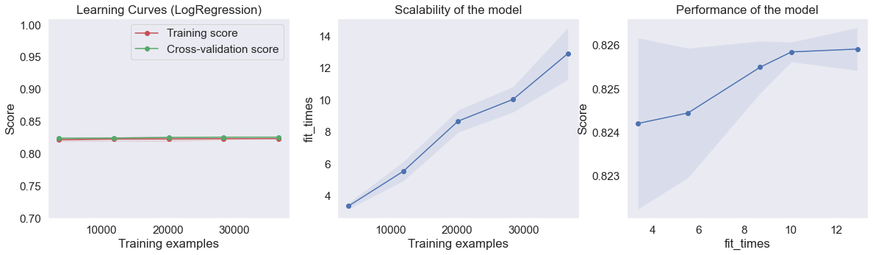
Appendix

Slide 19
THANK YOU

